Slide 1


🔒 NETWORK ANOMALY DETECTION
Ensemble Machine Learning on NSL-KDD Dataset
Course Title: Data Mining
Course Code: CSE 436
Section: 222 D1
Presented By
Presented To
Md. Robiul Islam – 222002068
Ashrafun Nahar Arifa – 222002066
Department of CSE,
Green University Of Bangladesh
Md. Atikuzzaman
Lecturer, Department of CSE
Green University Of Bangladesh

Slide 2
📚 Contents
💡 Introduction & Motivation
🎯 Problem Statement
📊 Dataset: NSL-KDD
⚙️ Methodology
🏗️ System Architecture
🏆 Model & Overall Performance
📺 Visualizations
🔗 Ensemble Results
🔑 Key Findings
🌐 REST API
⚠️ Challenges & Solutions
🔴 Limitations
🔮 Future Work
✅ Conclusions

Slide 3
💡 Introduction & Motivation
🎯 Network security threats evolve constantly
⚠️ Traditional systems fail against zero-day attacks
🤖 ML provides adaptive detection
🔍 Anomaly detection works without prior signatures
⚡ Goal: Production-ready system <1ms latency

Slide 4
🎯 Problem Statement
✖️ Real-time network intrusion detection
⚖️ Balance precision vs recall
📊 Handle 41 high-dimensional features
🔄 Manage class imbalance
⚡ Sub-second inference latency
🎛️ Tunable sensitivity

Slide 5
📊 Dataset: NSL-KDD
📦 Enhanced KDD Cup 1999
🔹 Training: 148,517 samples (51.9% normal)
🔹 Testing: 29,704 samples (55.2% normal)
🔢 Features: 41 (38 numeric, 3 categorical)
🎯 Attacks: DoS, Probe, R2L, U2R
✅ Binary: Normal vs Anomaly

Slide 6
⚙️ Methodology
🌲 ISOLATION FOREST
• 50 estimators, 256 samples
📍 LOCAL OUTLIER FACTOR
• 10 neighbors, multi-threaded
🔗 ENSEMBLE METHODS
• Voting, Averaging, Threshold, Stacking

Slide 7
🏗️ System Architecture
1️⃣ Preprocessing (encoding, scaling)
2️⃣ Model Training (parallel)
3️⃣ Ensemble Layer (4 strategies)
4️⃣ REST API (FastAPI)

Slide 8
🏆 Model & Overall Performance
🥇 ISOLATION FOREST
• F1: 0.2446 | ROC: 0.8476
• Precision: 71% | Recall: 15%
• TP: 2,110 | TN: 14,558
🥈 LOF: F1=0.1067 | ROC=0.4563
🥉 AE Baseline: F1=0.0451
🚀 TRAINING
• Total: ~20s | IF: 0.9s
⚡ INFERENCE
• 0.8ms/sample (1,250/sec)
💾 RESOURCES
• Memory: 450 MB
• Model: 285 KB | Total: <1 MB

Slide 9
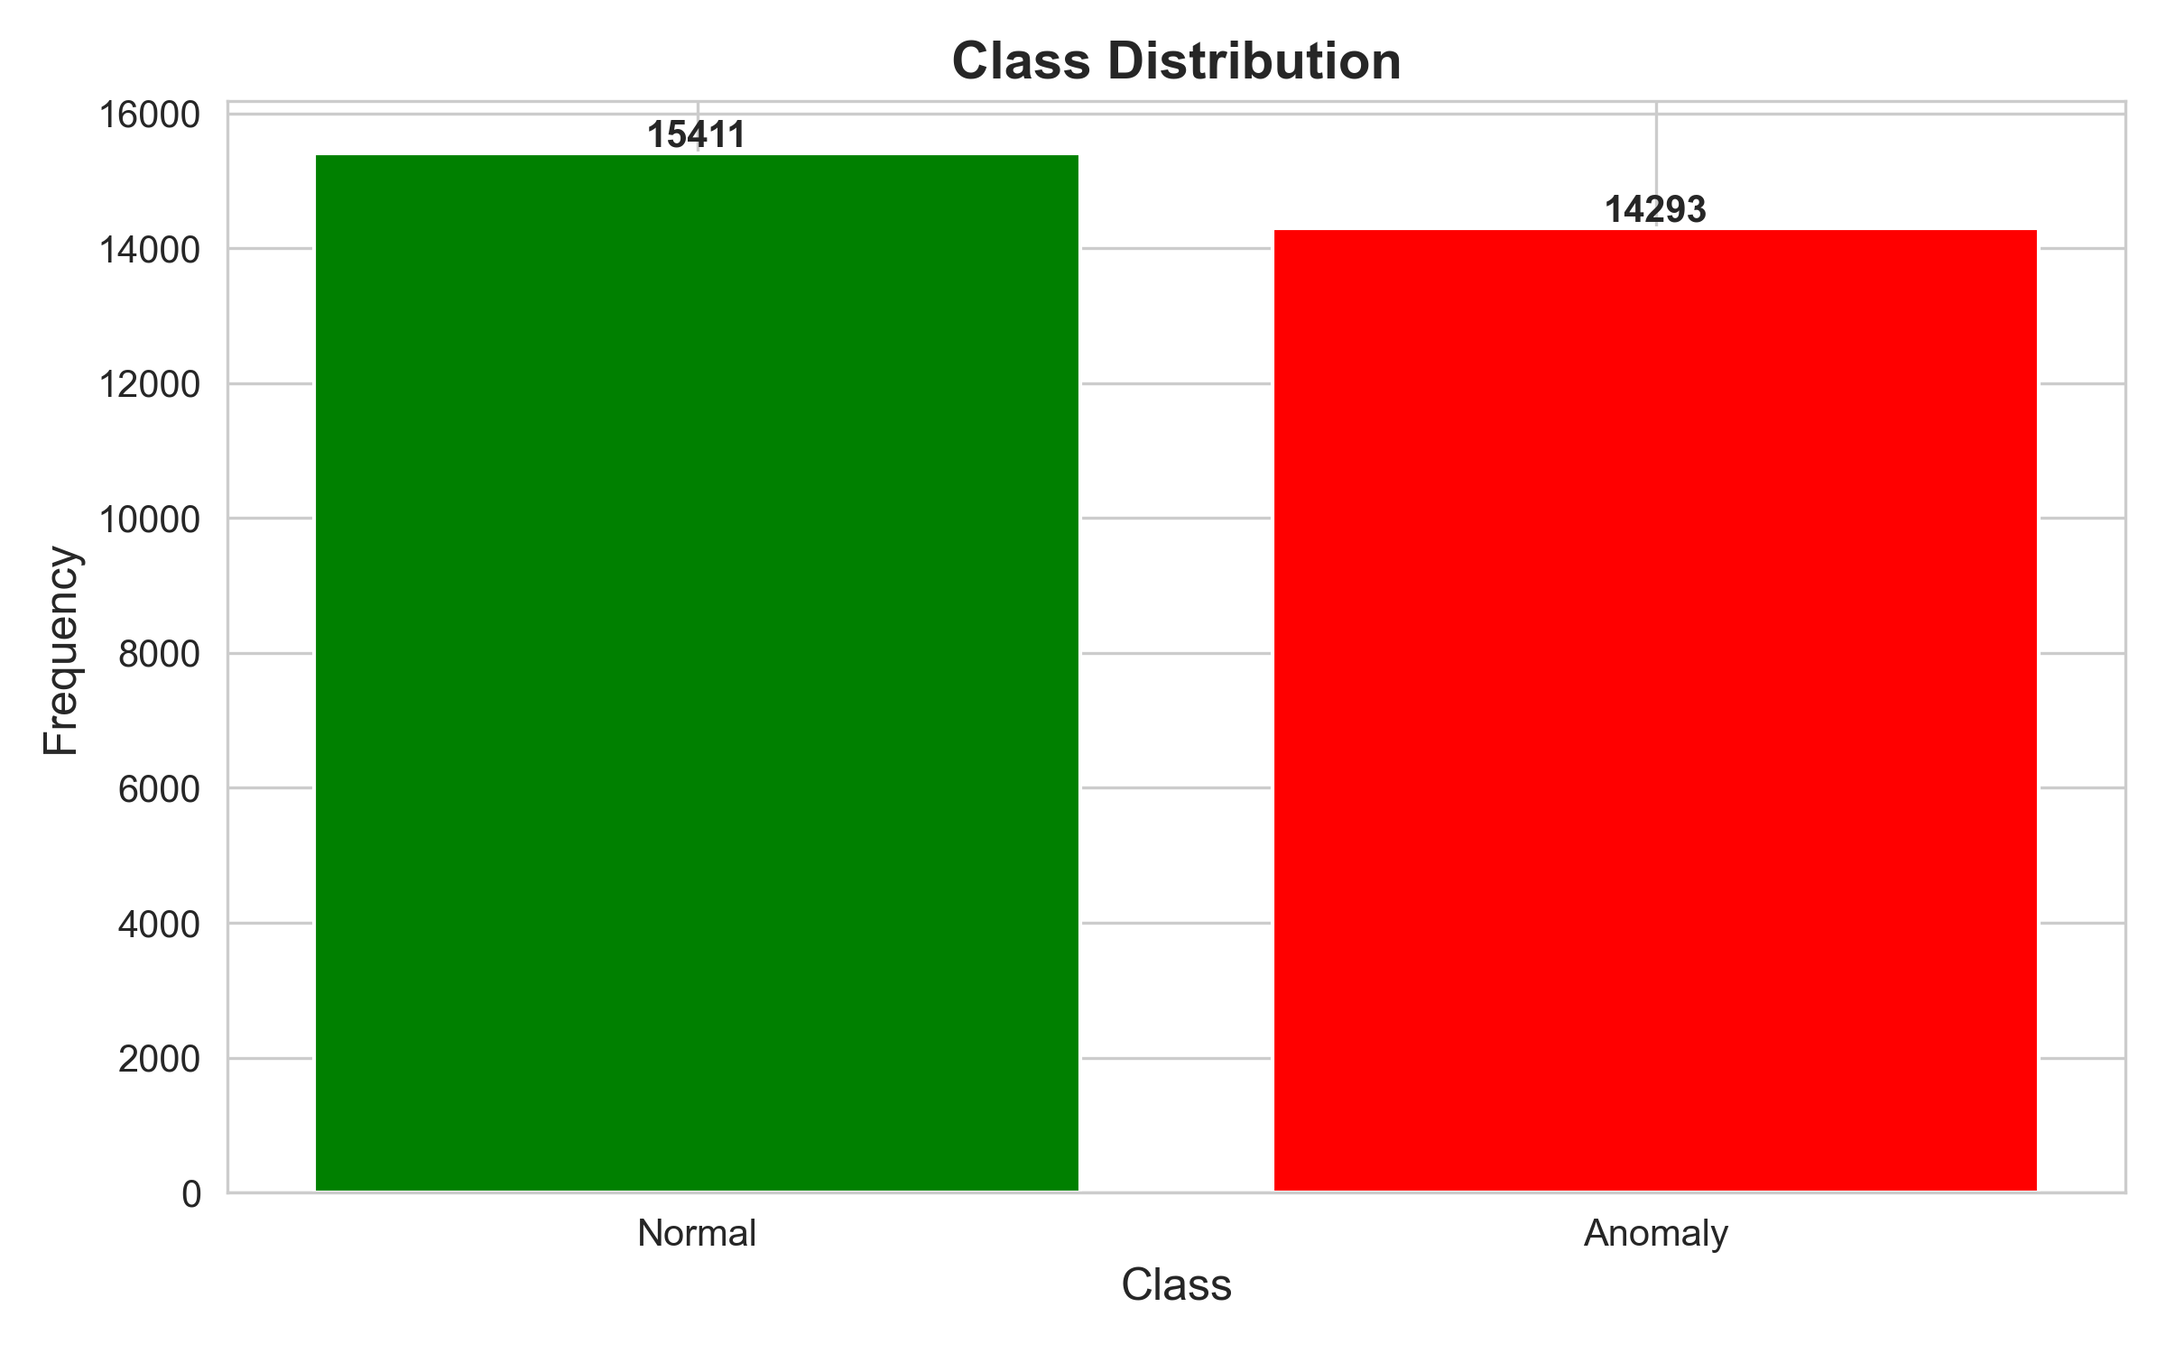
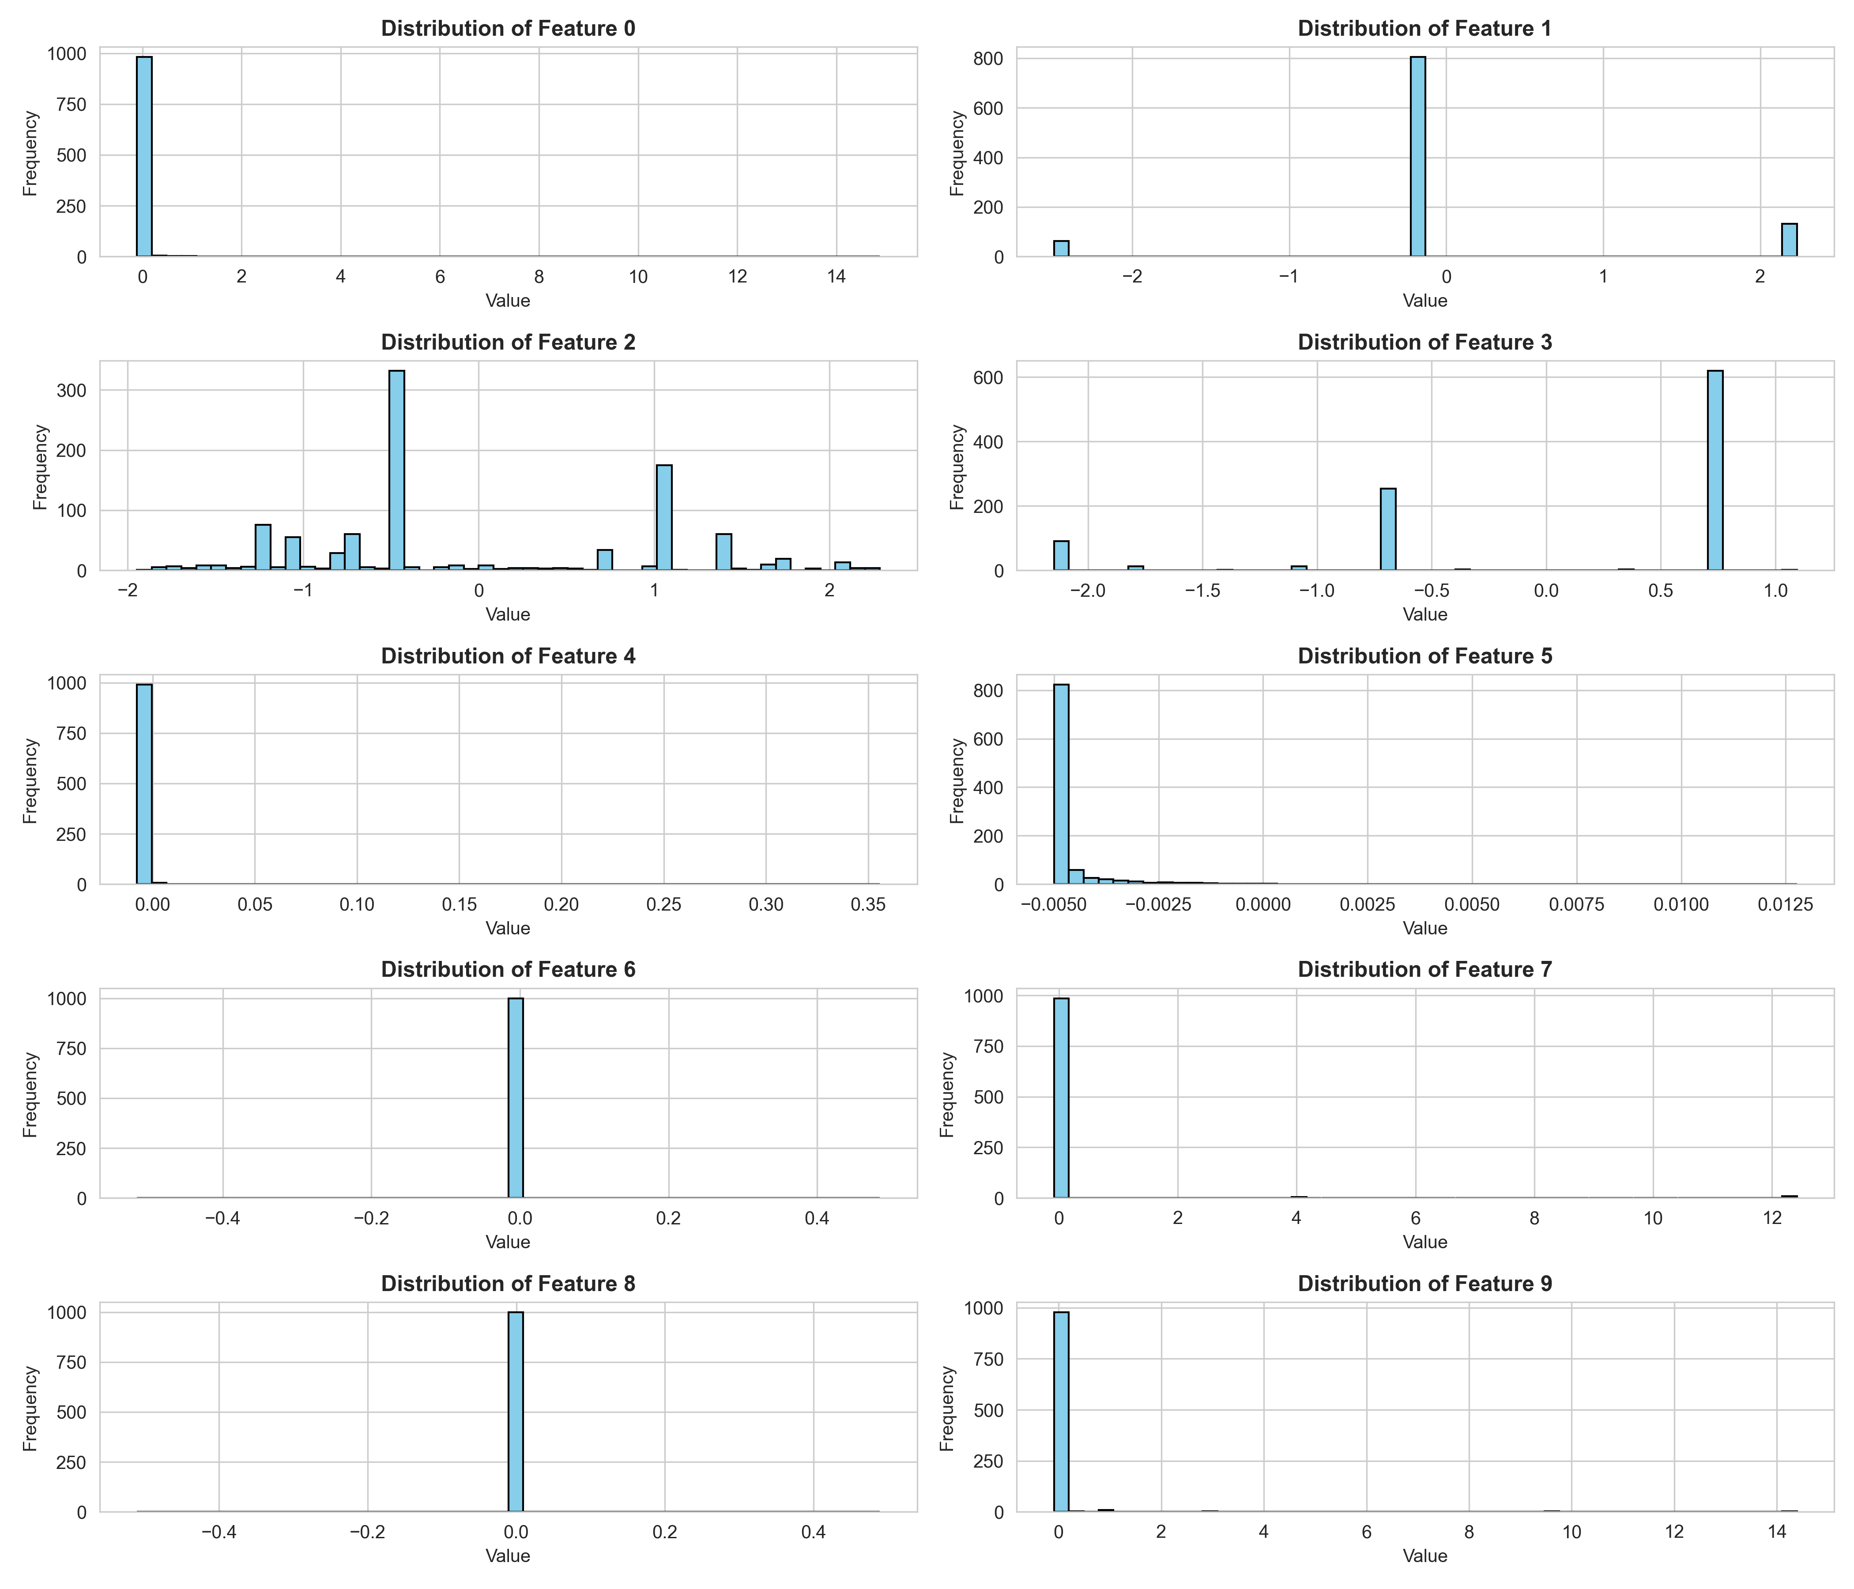
📊 Class Distribution & Feature Distribution
Training: 54% normal, 46% anomaly
Duration, bytes, errors show distinct patterns

Slide 10
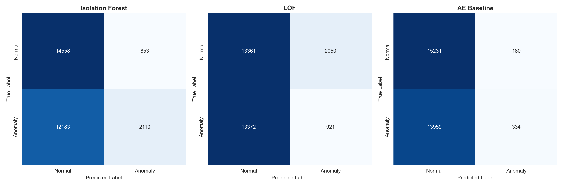
🔍 Confusion Matrices
It shows strong diagonal performance

Slide 11
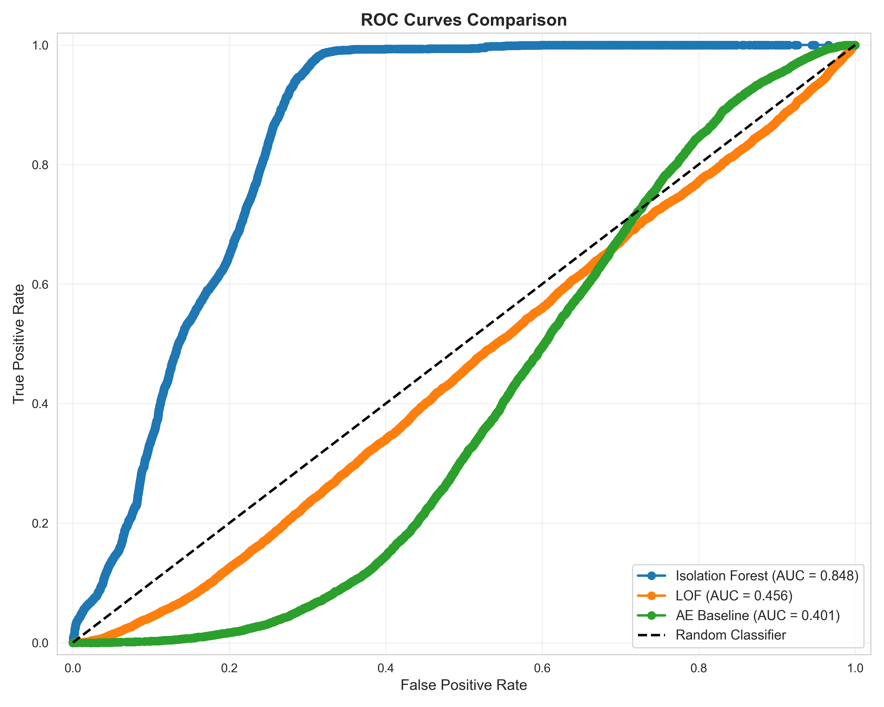
📉 ROC Curves
IF: 0.8476 AUC (excellent discrimination)

Slide 12
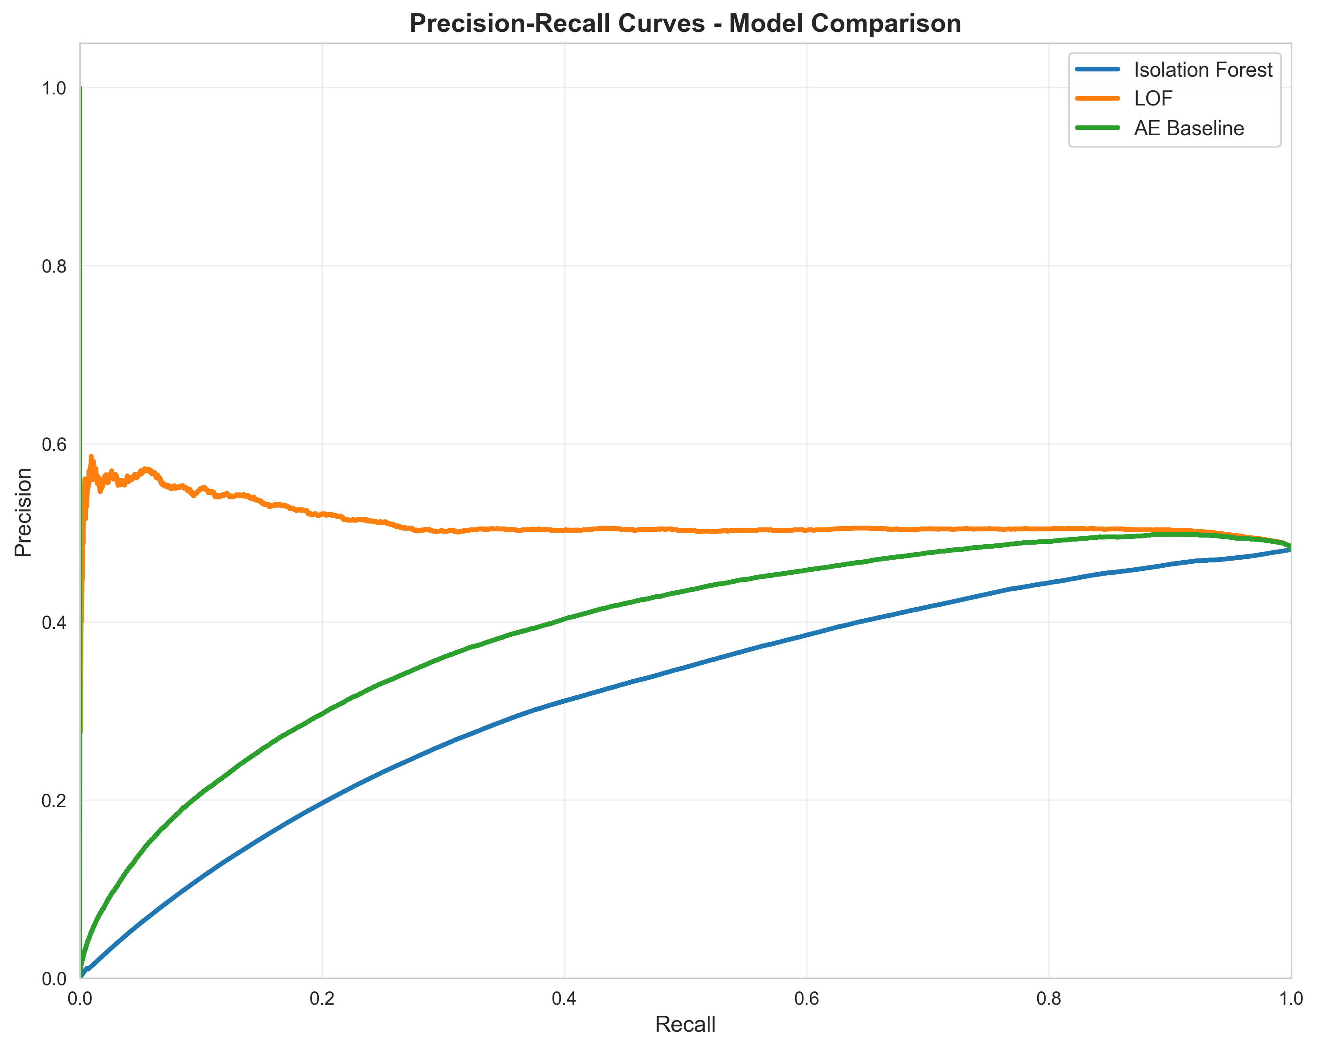
⚖️ Precision-Recall
IF >70% precision at low recall

Slide 13
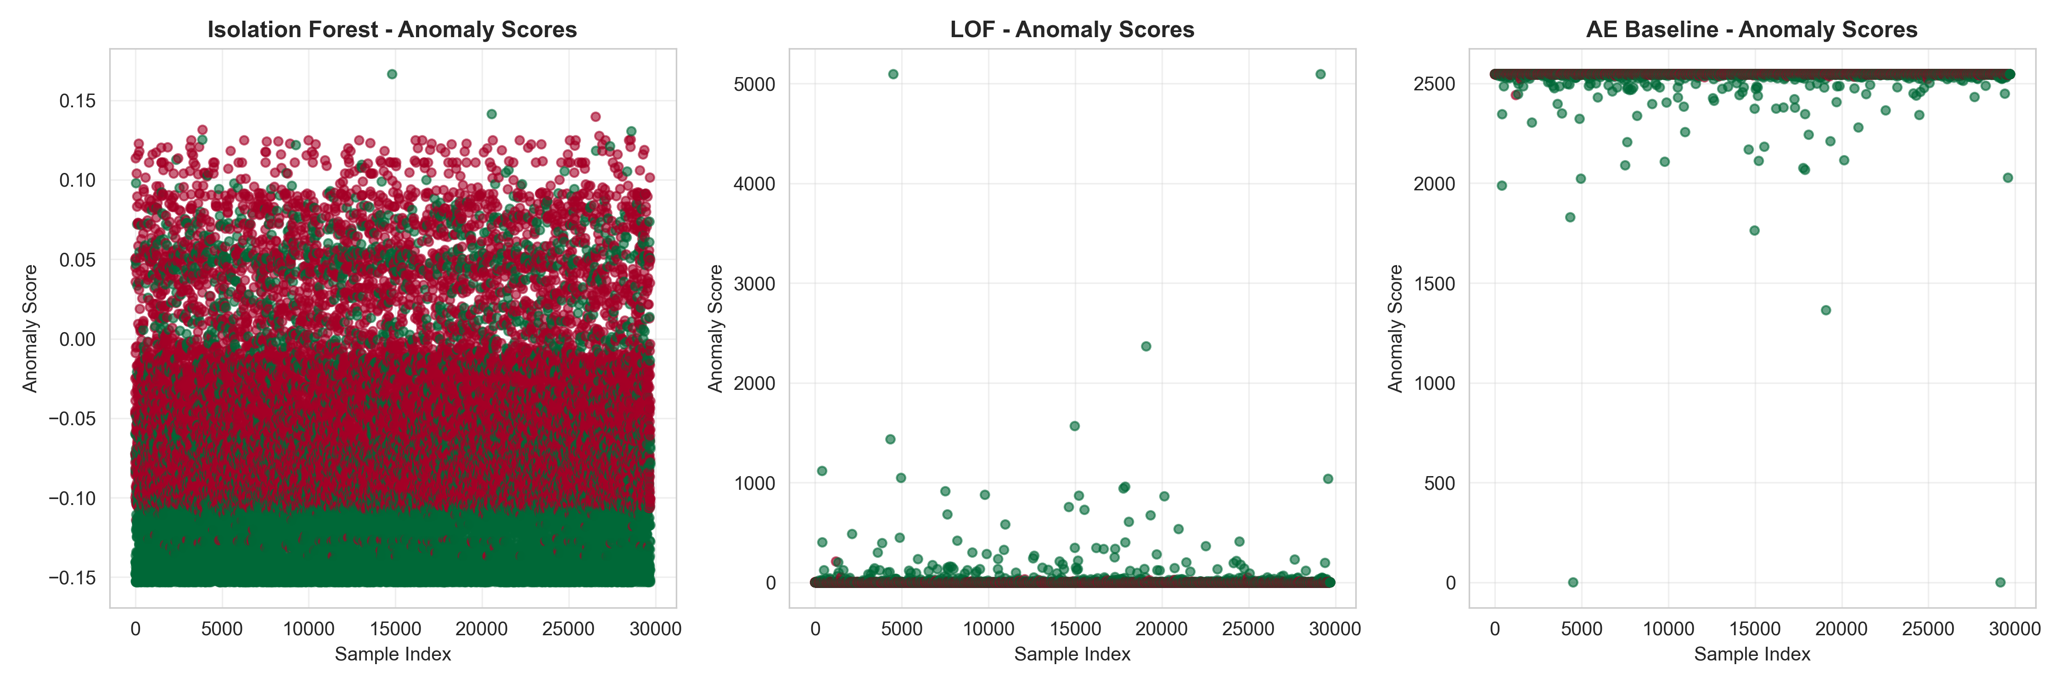
📊 Anomaly Scores
It shows clear separation

Slide 14
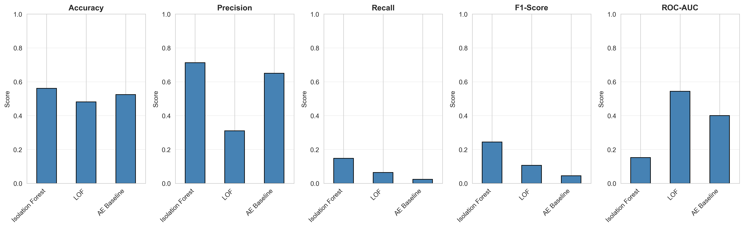
📊 Metrics Comparison
leads in all metrics

Slide 15
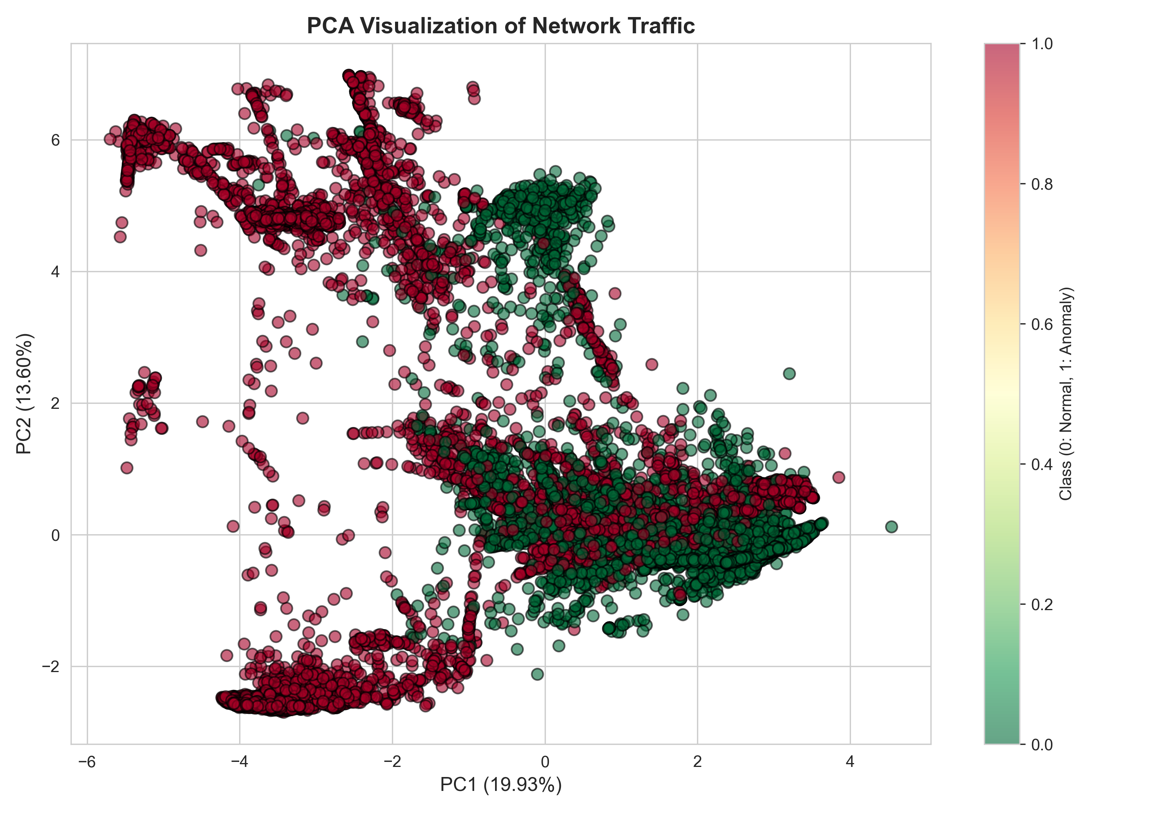
🎨 PCA Visualization
Moderate class separability

Slide 16
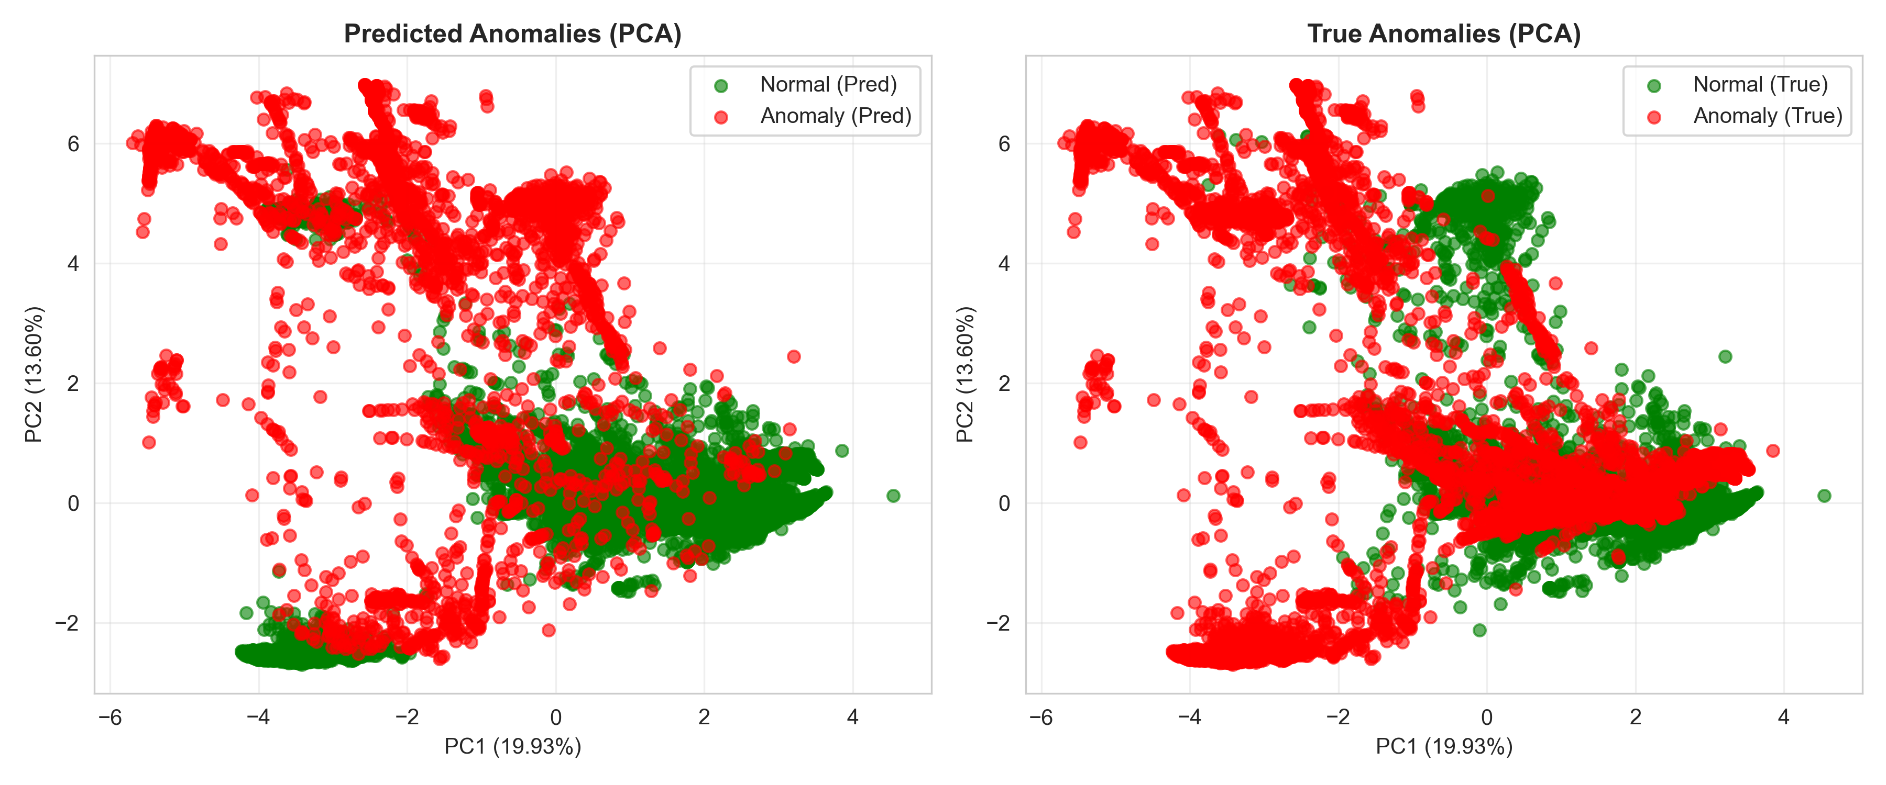
🎯 PCA Predictions
TP cluster in anomaly regions

Slide 17
🔗 Ensemble Results
🗳️ VOTING
• F1: 0.2446
📊 AVG SCORES
• F1: 0.6459
• Recall: 99%
⚖️ THRESHOLD
• F1: 0.4161
🎯 STACKING
• F1: 0.0451

Slide 18
🔑 Key Findings
✅ IF achieves 71% precision
⚖️ Critical precision-recall trade-off
🔧 Ensembles provide flexibility
• Voting: Conservative
• Avg: High sensitivity (99% recall)
• Threshold: Balanced

Slide 19
🌐 REST API
⚙️ FastAPI Service
• GET /health
• POST /predict
📥 JSON input with auto-preprocessing
📤 Predictions + scores
🚀 Docker/Kubernetes ready

Slide 20
⚠️ Challenges & Solutions
❌ LOF hanging
✅ Reduced neighbors to 10
❌ Autoencoder froze
✅ IF+LOF baseline
❌ Matplotlib delays
✅ Optimized plots
❌ Encoding errors
✅ UTF-8 enforcement

Slide 21
🔴 Limitations
⚠️ Low recall (≤15%)
⚠️ Single dataset (NSL-KDD 2009)
⚠️ Static models (no drift detection)
⚠️ Limited feature engineering

Slide 22
🔮 Future Work
🔍 SHAP feature importance
🔄 K-fold cross-validation
🎯 Threshold optimization
📊 Multi-dataset evaluation
📡 Real-time drift detection
🧠 Deep learning with GPU
☁️ Kubernetes deployment
🔗 SIEM integration

Slide 23
✅ Conclusions
🏆 Production-ready system built
🎯 ACHIEVEMENTS
• IF: F1=0.2446, ROC=0.8476
• 4 ensemble strategies
• <1ms inference API
• 10 visualizations
💡 Ready for deployment

Slide 24
🔒 THANK YOU!
QUESTIONS?

